Slide 1
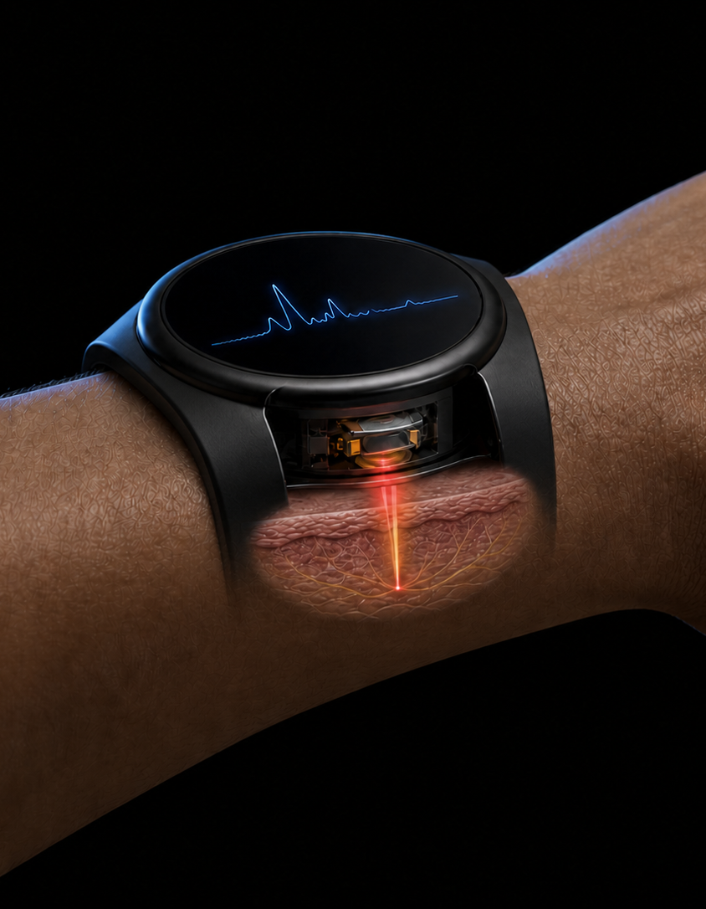

THCS LEARNING WEEK 2026
A PHOTONICS21
PERSPECTIVE ON
HEALTH-SYSTEM
TRANSFORMATION
From enabling technology to routine care
Prof. Dr. Jürgen Popp
Photonics21 · 28 September 2026
Conceptual illustration

Slide 2

The Photonics21 position
European capability, faster deployment and cross-sector missions
Photonics enables critical sectors, including healthcare, AI and semiconductors.
€2bn
public funding proposed for a stand-alone
photonics programme in the 2028–2034 MFF
€6–8bn
total programme envisaged to accelerate
innovation, manufacturing and deployment
GRAND CHALLENGES
Full innovation pathway
Research and prototyping, pilot manufacturing, industrialisation and deployment
BREAK SILOS
Health missions require cross-sector collaboration
2
THCS Learning Week 2026

Slide 3
Transformation changes care
The Photonics21 ambition meets the THCS implementation perspective
CURRENT PATTERN
TRANSFORMATIVE SHIFT
01
Reactive treatment
Prevention and earlier action
02
Centralised specialist care
Point of care and home
03
Episodic snapshots
Longitudinal insight
04
Isolated measurements
Clinically actionable decisions
A successful pilot shows progress. Durable routine use shows transformation.
3
THCS Learning Week 2026

Slide 4

PHOTONICS21 GRAND CHALLENGE
PERSONALISED OPTICAL
DIGITAL TWIN
All relevant physical and molecular measurements fused through trustworthy AI
01
Physical measurements
Optical, electrical, acoustic and physiological signals
02
Molecular measurements
Spectroscopy and biochemical markers from tissues and biofluids
03
Trustworthy AI fusion
Quality control, alignment and modelling across modalities
04
Clinical twin
Individual baseline, meaningful change and decision support
POSITION PAPER PROPOSAL
€700–900m public investment over 10 years
R&D, pilot manufacturing, clinical integration, ecosystem and skills
Conceptual illustration

Slide 5
PODT in Europe’s VHT ecosystem
European foundations and the contribution of this session
EUROPEAN FOUNDATION
SESSION CONTRIBUTION
VHT Initiative
Direction, ecosystem and European investment
PHOTONICS21
Optical and molecular measurement technologies
EDITH roadmap
Integrated, multiscale VHT building blocks
ADRA
Trustworthy AI for multimodal fusion
Advanced VHT platform
Model integration and validation
ERA4HEALTH
Prospective clinical validation
EHDS
Secure, interoperable health-data framework
THCS
Implementation across health systems
PODT supplies the multimodal measurement and updating layer
for Europe’s Virtual Human Twin ecosystem.
5
THCS Learning Week 2026

Slide 6
The work ahead
What Europe’s partnerships must now build together
Europe has the technology base. The partnerships must now build the pathway into routine care.
01
Shared health challenge
Define one unmet need, one clinical decision and the outcomes that matter
02
Co-design from the start
Bring patients, clinicians, measurement teams, AI experts and payers into the design
03
Aligned programmes
Connect calls, evidence requirements, demonstrators and handovers
04
Validation across systems
Test clinical value, workflow impact and transferability in several countries
05
Conditions for scale
Prepare standards, reimbursement, manufacturing, skills and ownership
Immediate opportunity: one cross-partnership demonstrator
built around a real care pathway
6
THCS Learning Week 2026

